Slide 1
Computer Organization and Design Transistors and all that… a brief overview
Montek Singh
Mar 21, 2016
Lecture 9

Slide 2
Today’s Topics
Where are we in this course?
Today’s topics
Why go digital?
Encoding bits using voltages
Digital design primitives
transistors and gates

Slide 3
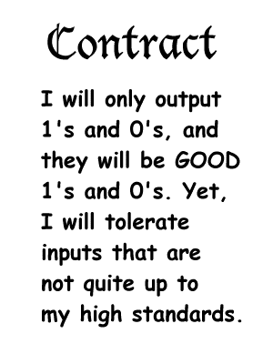
Let’s go digital!
Why DIGITAL?
… because it helps guarantee a reliable system
The price we pay for this robustness?
All the information that we transfer between components is only 1 crummy bit!
But, in exchange, we get a guarantee of a reliable system.
0 or 1

Slide 4
The Digital Abstraction
“Ideal” Abstract World
Real World
Manufacturing Variations
0/1
Noise
Bits
Volts or
Electrons or
Ergs or Gallons
Keep in mind, the world is not digital, we engineer it to behave so. We must use real physical phenomena to implement digital designs!

Slide 5
Types of Digital Components
Two categories of components
those whose output only depends on their current inputs
called COMBINATIONAL
they are “memory-less”, don’t remember the past
those who output depends also on their past state
called SEQUENTIAL
they are “state-holding”, remember their past
key to building memories

Slide 6
Terminology
System
a reasonably large assembly of components
division of a system into components is typically arbitrary but almost always hierarchical
Component/Element
an individual part of a bigger system
clearly-defined function and interface
implement it and put a black-box around it
larger components created using smaller components
Circuit
a small (often leaf-level) component consisting of a network of gates

Slide 7
Combinational Components
A circuit is combinational if-and-only-if it has:
one or more digital inputs
one or more digital outputs
a functional specification that details the value of each output for every possible combination of valid input values
output depends only on the latest inputs
a timing specification consisting (at minimum) of an upper bound t_{pd} on the time this circuit will take to produce the output value once stable valid input values are applied
Output a “1” if at
least 2 out of 3 of
my inputs are a “1”.
Otherwise, output “0”.
input A
input B
output Y
input C
I will generate a valid
output in no more than
2 minutes after
seeing valid inputs

Slide 8
A Combinational Digital System
Theorem: A system of interconnected elements is combinational if-and-only-if:
each primitive circuit element is combinational
every input is connected to exactly one output or directly to a source of 0’s or 1’s
the circuit contains no directed cycles
no feedback (yet!)
Proof: By induction
Start with the rightmost level of elements
their output only depends on their inputs, which in turn are outputs of the level of element just to their left
and so on… until you arrive at the leftmost inputs
But, in order to realize digital processing elements we have one more requirement!

Slide 9
Noise Margins
Key idea: Keep “0”s distinct from the “1”s
say, “0” is represented by min voltage (e.g., 0 volts)
… “1” is represented by high voltage (e.g., 1.8 volts)
use the same voltage representation throughout the entire system!
For reliability, outlaw “close calls”
forbid a range of voltages between “0” and “1”
Invalid
Valid
“0”
Valid
“1”
Forbidden Zone
Min Voltage
volts
Max Voltage
CONSEQUENCE: Notion of “VALID” and “INVALID” logic levels

Slide 10
Digital Processing Elements
Some digital processing elements occur so frequently that we give them special names and symbols
I will copy and restore my input to my output
I will output the complement of
my input
A
Y
A
Y
buffer
inverter
A
A
I will output a
‘1’ if any of my
inputs are ‘1’
I will only output a ‘1’ if all my
inputs are ‘1’
Y
Y
AND
OR
B
B
A
I will only output a
‘1’ if an odd number
of my inputs are ‘1’
XOR
Y
B

Slide 11
Digital Processing Elements
Some digital processing elements occur so frequently that we give them special names and symbols
A
Y
A
Y
buffer
inverter
A
A
Y
OR
Y
AND
B
B
A
XOR
Y
B

Slide 12
Most common technology today
… is called CMOS
everything built using transistors
a transistor is just a switch
2 types of transistors
n-type
called “NFET”, or “nMOS” or “n channel transistor” or “n transistor”
switch is on (i.e., conducts) when its control input is ‘1’
p-type
called “PFET”, or “pMOS”, or “p channel transistor” or “p transistor”
switch is on (i.e., conducts) when its control input is ‘0’
need both types to build useful gates

Slide 13
Transistors as switches
At an abstract level, transistors are merely switches
3-ported voltage-controlled switch
n-type: conduct when control input is 1
p-type: conduct when control input is 0

Slide 14
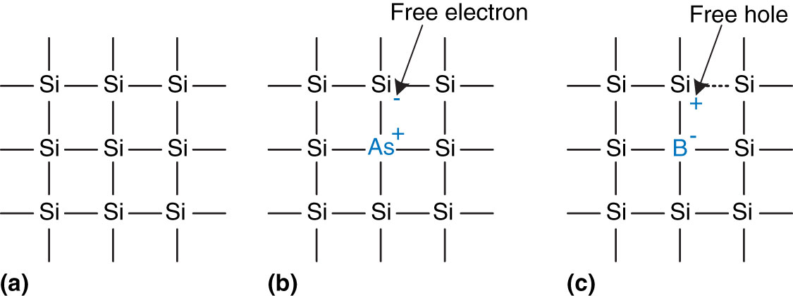
Silicon as a semiconductor
Transistors are built from silicon
Pure Si itself does not conduct well
Impurities are added to make it conducting
As provides free electrons → n-type
B provides free “holes” → p-type
Silicon lattice and dopant atoms (from Harris and Harris)

Slide 15
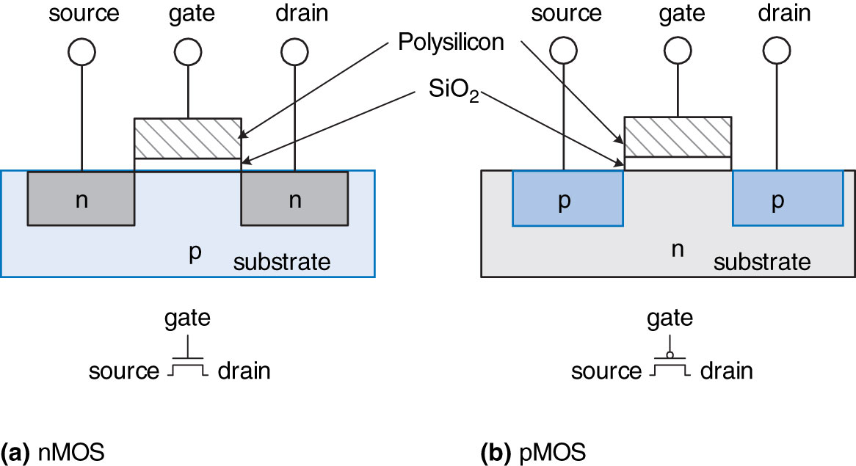
MOS Transistors
MOS = Metal-oxide semiconductor
3 terminals
gate: the voltage here controls whether current flows
source and drain: are what the current flows between
structurally, source and drain are the same
nMOS and pMOS transistors (from Harris and Harris)

Slide 16
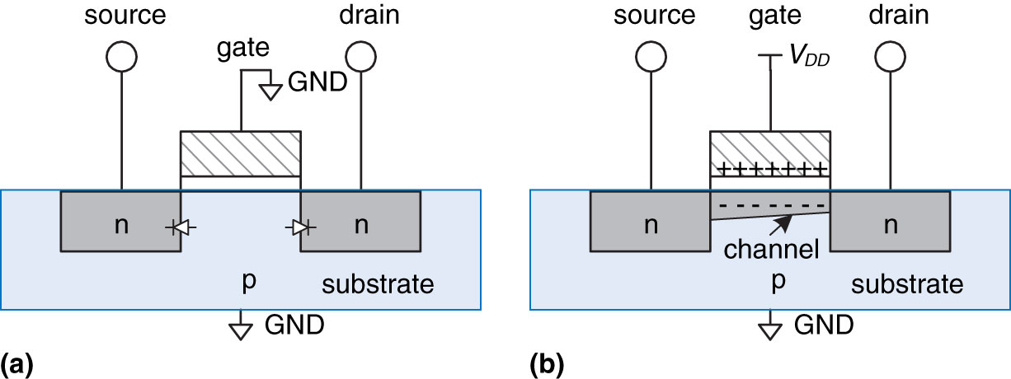
nMOS Transistors
Gate = 0
OFF = disconnect
no current flows between source & drain
Gate = 1
ON= connect
current can flow between source & drain
positive gate voltage draws in electrons to form a channel
nMOS transistor operation (from Harris and Harris)

Slide 17
pMOS Transistors
Just the opposite
Gate = 1 → disconnect
Gate = 0 → connect

Slide 18
Summary: nMOS and pMOS Transistors
Summary:
Notes:
N type top
P type bottom
P type has a circle at the gate
Transistor only makes a connection or breaks a connection

Slide 19
CMOS Topologies
There is actually more to it than connect/disconnect
nMOS: pass good 0’s, but bad 1’s
so connect source to GND
pMOS: pass good 1’s, but bad 0’s
so connect source to V_{DD}
Typically use them in complementary fashion:
nMOS network at bottom
pulls output value down to 0
pMOS network at top
pulls output value up to 1
only one of the two networks must conduct at a time!
or smoke may be produced
if neither network conducts → output will be floating
Notes:
P transistors always a the top connected to high voltage (t shaped thing rep. overhead high voltage wire)
N is always at the bottom (the triangle indicates ground which is zero voltage)
N can either make or break a path from the ground to the output
Input goes into both, and output comes out
Path could be made from ground to output, which means output gets connected to ground and output is zero.
P is suppose to make a path from 1 to the output, meaning the output becomes 1
N transistors are “pull down network” pulls the output voltage to 0

Slide 20
From Transistors… to Gates!
Logic Gate recipe:
use complementary arrangements of PFETs and NFETs
called CMOS (“complementary metal-oxide semiconductor”)
at any time: either “pullup” active, or “pulldown”, never both!
V_{DD}
We’ll use p-type here
pullup: make this connection when V_{IN} is near 0 so that V_{OUT} = V_{DD}
V_{IN}
V_{OUT}
pulldown: make this connection when V_{IN} is near V_{DD} so that V_{OUT} = 0
and, n-type here
Gnd
Notes:
If the input is 0, the top will conduct and try to send a 1 to the output
If the input is 1, the top is disconnected so the output gets connect to zero and the output is zero

Slide 21
CMOS Inverter
“0”
“1”
V_{out}
Valid “1”
V_{in}
V_{out}
Invalid
“1”
“0”
Valid “0”
V_{in}
Only a narrow range of input voltages result in “invalid” output values. (This diagram is greatly exaggerated)
A
Y
inverter
Notes:
What if the input is between zero and one?

Slide 22
CMOS Complements
A
A
conducts when A is high
conducts when A is low
A
Series N connections:
A
B
B
Parallel P connections:
conducts when A is high and B is high: A.B
conducts when A is low or B is low: A+B = A.B
A
A
B
Parallel N connections:
B
Series P connections:
conducts when A is high or B is high: A+B
conducts when A is low and B is low: A.B = A+B

Slide 23
A Two Input Logic Gate
What function does
this gate compute?
A B Y
Y
A
0 0
0 1
1 0
1 1
B
(see next slide)

Slide 24
NAND
A | B | P1 | P2 | N1 | N2 | Y
0 | 0 | ON | ON | OFF | OFF | 1
0 | 1 | ON | OFF | OFF | ON | 1
1 | 0 | OFF | ON | ON | OFF | 1
1 | 1 | OFF | OFF | ON | ON | 0

Slide 25
Here’s Another…
B
What function does
this gate compute?
A B C
0 0
0 1
1 0
1 1
1
0
0
0
A
2-input NOR gate

Slide 26
3-input NOR Gate?

Slide 27
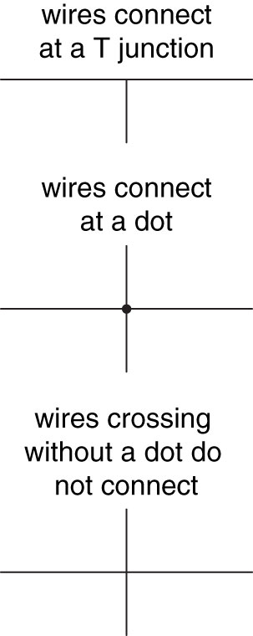
Drawing Style
Indicate inputs and outputs using arrows
or: inputs at left/top, outputs at right/bottom
If possible, gates should flow from left to right
or: top to bottom
Straight wires best
or: keep bends at a minimum (preferably 90 deg)
Connections:
wires always connect at a “T” junction
a dot at a wire crossing indicates connection
wire crossing without a dot means no connection

Slide 28
Circuit Schematic Rules (cont.)
Wire connections
A dot where wires cross indicates a connection
Wires crossing without a dot make no connection
Wires always connect at a T junction

Slide 29
CMOS Gates Like to Invert
Observation: CMOS gates tend to be inverting!
One or more “0” inputs are necessary to generate a “1” output
One or more “1” inputs are necessary to generate a “0” output
Why?
B
A

Slide 30
General CMOS Gate Recipe
Step 1. Figure out pulldown network that does what you want (i.e the set of conditions where the output is ‘0’) e.g., F = A*(B+C)
A
B
C
Step 2. Walk the hierarchy replacing nfets with pfets, series subnets with parallel subnets, and parallel subnets with series subnets
B
A
C
Step 3. Combine pfet pullup network from Step 2 with nfet pulldown
network from Step 1 to form fully-complementary CMOS gate.
A
B
C
A
B
C
Notes:
A must be on, either B or C has to be on to work

Slide 31
One More Exercise
Lets construct a gate to compute:
F = A+BC = NOT(OR(A,AND(B,C)))
Step 1: Draw the pull-down network
Step 2: The complementary pull-up network
V_{dd}
A
B
C
F
A
B
C

Slide 32
One More Exercise
Lets construct a gate to compute:
F = A+BC = NOT(OR(A,AND(B,C)))
Step 1: Draw the pull-down network
Step 2: The complementary pull-up network
Step 3: Combine and Verify
V_{dd}
A
B
C
F
A | B | C | F
0 | 0 | 0
0 | 0 | 1
0 | 1 | 0
0 | 1 | 1
1 | 0 | 0
1 | 0 | 1
1 | 1 | 0
1 | 1 | 1
A
B
1
1
1
0
0
0
0
0
C

